Slide 1

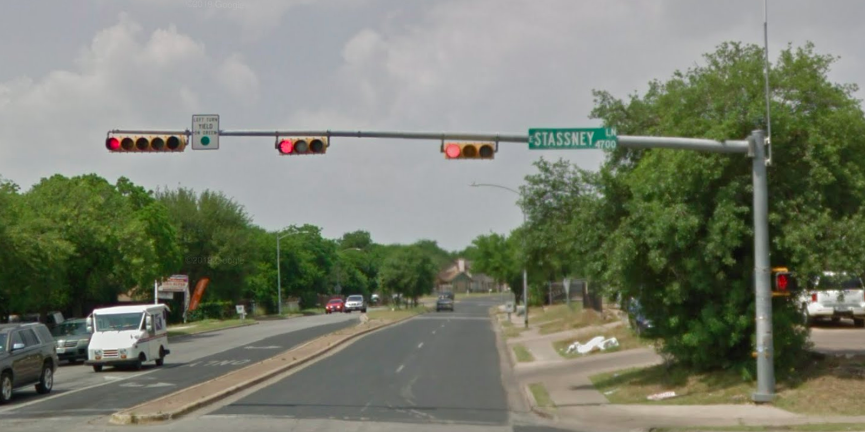
Austin Transportation Department Signs Work Orders
Created By: Susanne Gov Created Date: 2020-08-10 Location Name: PLEASANT VALLEY RD / STASSNEY LN Intersection ID: 5157006 Cardinal Direction: N Work Order ID: SG-20344
Sign Type | Install/Remove
Street Name Sign | Install

Slide 2
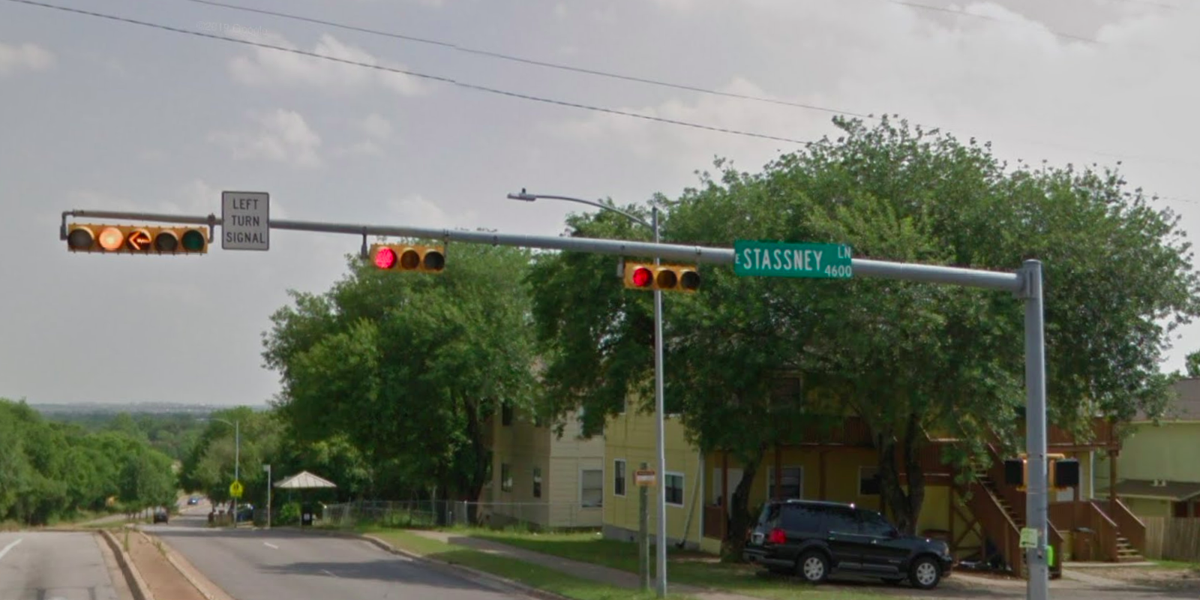
Austin Transportation Department Signs Work Orders
Created By: Susanne Gov Created Date: 2020-08-10 Location Name: PLEASANT VALLEY RD / STASSNEY LN Intersection ID: 5157006 Cardinal Direction: S Work Order ID: SG-20344
Sign Type | Install/Remove
Street Name Sign | Install
Left Turn Signal | Install

Slide 3
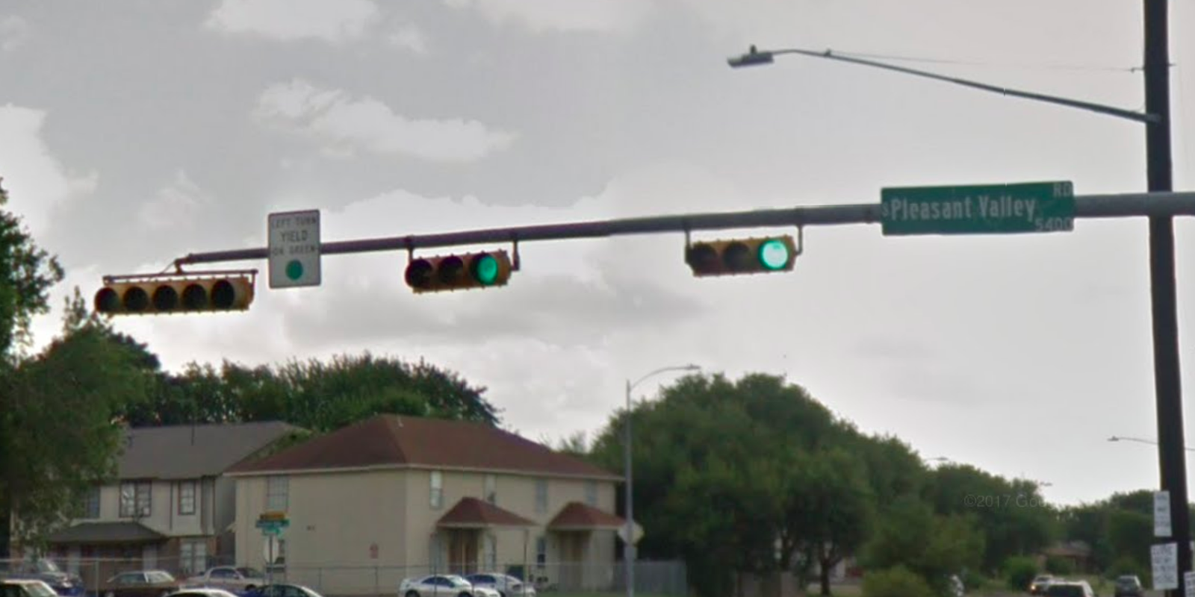
Austin Transportation Department Signs Work Orders
Created By: Susanne Gov Created Date: 2020-08-10 Location Name: PLEASANT VALLEY RD / STASSNEY LN Intersection ID: 5157006 Cardinal Direction: E Work Order ID: SG-20344
Sign Type | Install/Remove
Street Name Sign | Install

Slide 4
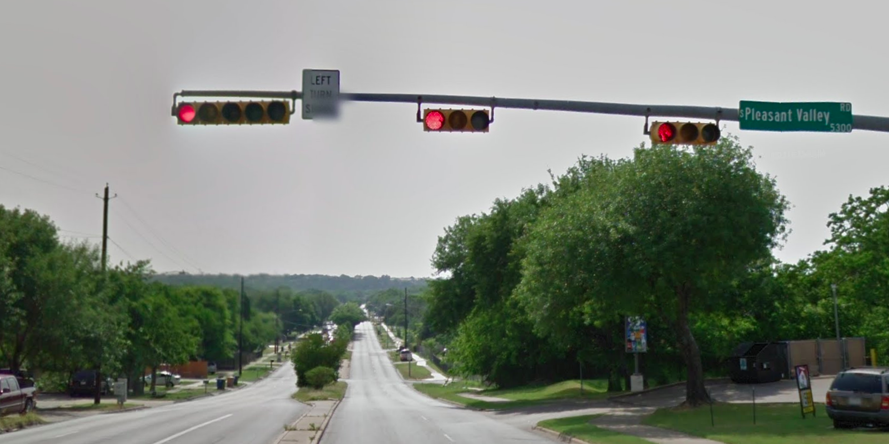
Austin Transportation Department Signs Work Orders
Created By: Susanne Gov Created Date: 2020-08-10 Location Name: PLEASANT VALLEY RD / STASSNEY LN Intersection ID: 5157006 Cardinal Direction: W Work Order ID: SG-20344
Sign Type | Install/Remove
Left Turn Signal | Install
Street Name Sign | Install

